Slide 1

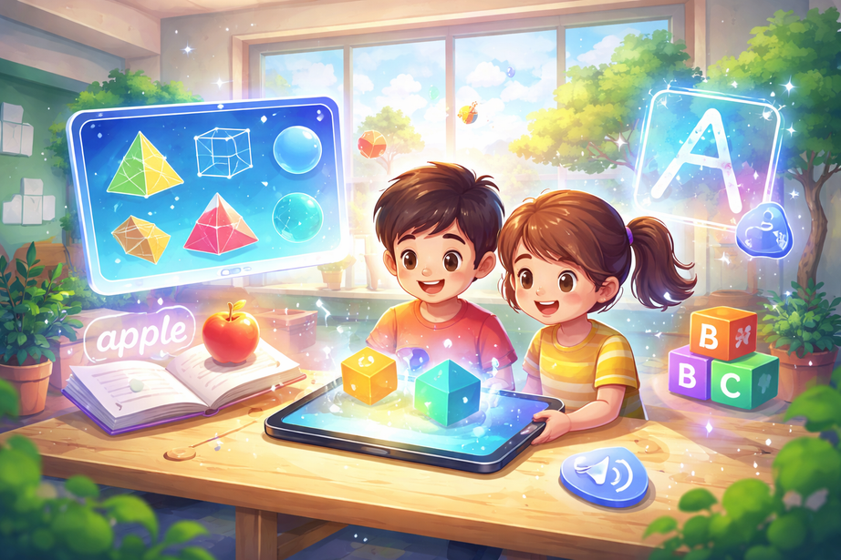

AR Educational Suite
For Primary Students’ Geometry and Literacy
R26-IM-005
SLIIT | Faculty of Computing | Interactive Media Specialization | 2026

Slide 2
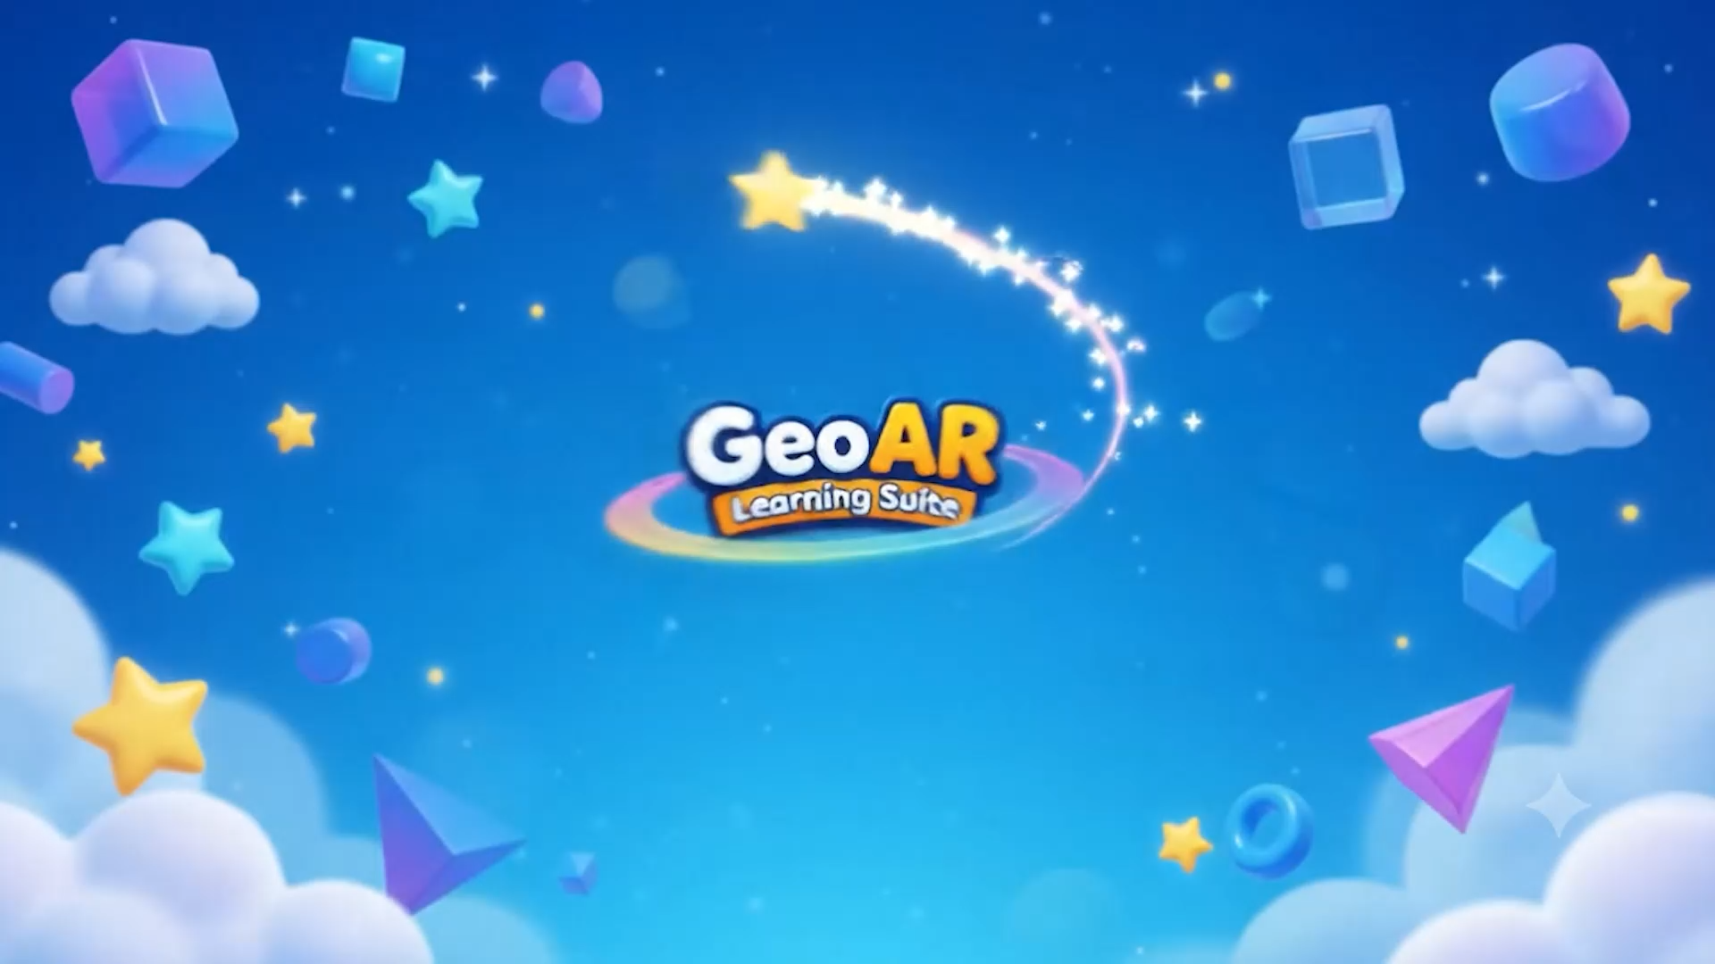
SLIIT | Faculty of Computing | Interactive Media Specialization | 2026

Slide 3
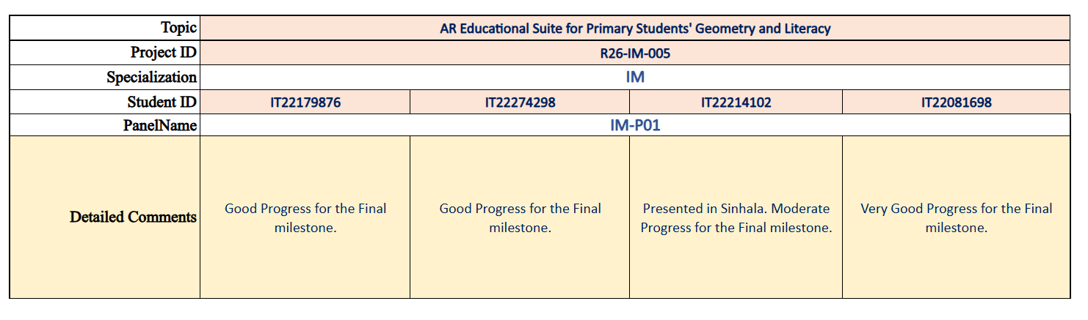
PP1 Comment
SLIIT | Faculty of Computing | Interactive Media Specialization | 2026

Slide 4
Problem
How can a mobile-based AI and Augmented Reality (AR) system be designed to accurately convert student-drawn 2D sketches into validated 3D geometric models, verify geometric net correctness, and simultaneously support English letter stroke guidance and vocabulary learning in a single low-cost, real-time interactive educational environment optimized for primary school learners (ages 6–12)?
Stakeholders
Students
Students (Age 6-12)
Teachers (Primary Grades)
Parents
Schools & Institutions
Measurable Pain Point
Geometry pain
Static 2D textbook diagrams make it difficult for children to visualize how nets fold into 3D solids, volumes, and fractions.
Literacy pain
Teachers cannot individually monitor every child’s English letter stroke order, direction, spelling, and pronunciation in real time.
Classroom constraint
Physical kits, high-end sensors, and specialist supervision are costly or impractical for many schools.
SLIIT | Faculty of Computing | Interactive Media Specialization | 2026

Slide 5
Research gap and objectives
Current limitations
Research objectives
1
AR apps mostly visualize pre-made 3D objects rather than validating learner-created sketches.
C1
Validate 2D geometric nets and generate 3D models
C2
Explain spatial errors through ghost overlay and slicing
Stakeholders
2
Feedback is often binary: correct / incorrect, with weak explanation of why an error happened.
C3
Track air-writing trajectories and correct stroke order
3
Literacy apps often check final letters, not real-time 3D stroke order, direction, word match, and pronunciation.
C4
Connect sketch, word, pronunciation, and AR reward
SLIIT | Faculty of Computing | Interactive Media Specialization | 2026

Slide 6
Solution overview: one integrated learning loop
1
2
3
4
5
Draw / capture
2D net or object sketch
Validate / compare
Geometry logic + reference guide
Generate AR model
Fold, rotate, slice, inspect
Air-write word
3D fingertip trajectory + stroke order
Speak + reward
Pronunciation match + animated 3D feedback
Stakeholders
SLIIT | Faculty of Computing | Interactive Media Specialization | 2026

Slide 7
Architecture and component integration
C1
2D→3D Geometry
Validation
C2
Scaffolding +
Virtual Slicing
C3
Air-Writing
Trajectory Tracking
C4
Phonics +
Vocabulary Reward
Student
input
Stakeholders
AR mobile interface
Unity 3D + ARCore
Shared services
feedback, logs, datasets, privacy
Evidence layer
metrics, tests, user feedback
SLIIT | Faculty of Computing | Interactive Media Specialization | 2026

Slide 8
Integration and completion status
Area
Evidence to show
Status
End-to-end demo path
Sketch → validation → AR feedback → writing → vocabulary reward
100 %
Stakeholders
Component integration
C1–C4 data handoffs, shared UI, event triggers, logging
80 %
Testing setup
Prepared test data, sample sketches, stroke cases, backup recording
90 %
Deployment readiness
Android / ARCore build, device setup, offline contingency
100%
SLIIT | Faculty of Computing | Interactive Media Specialization | 2026

Slide 9
Evaluation evidence and non-functional requirements
Metric
What it proves
Result
Sketch / net validation accuracy
Geometry recognition and foldability correctness
85%
Stroke recognition + direction accuracy
Trajectory model and canonical path validation
90%
Pre-test vs post-test improvement
Learning gain in spatial and literacy tasks
75%
Stakeholders
System response time / latency
Real-time classroom usability
user feedback
Usability and engagement for ages 6–12
9/10
NFRs to defend
Performance within a real-time threshold; simple child-friendly UI; ARCore Android compatibility; anonymized data; consent for minors; safe, offline-friendly classroom interaction.
SLIIT | Faculty of Computing | Interactive Media Specialization | 2026

Slide 10
Commercialization and demo roadmap
Target users and buyers
Primary students are direct users; teachers and schools facilitate adoption; parents and tuition centres can support home learning.
Value proposition
Low-cost mobile AR learning that gives instant visual correction and reduces the need for one-to-one supervision.
Stakeholders
Revenue path
Pilot with schools → Premium app → school licence / subscription → content expansion for more shapes and language packs.
SLIIT | Faculty of Computing | Interactive Media Specialization | 2026

Slide 11
Q & A
Stakeholders
SLIIT | Faculty of Computing | Interactive Media Specialization | 2026

