Slide 1





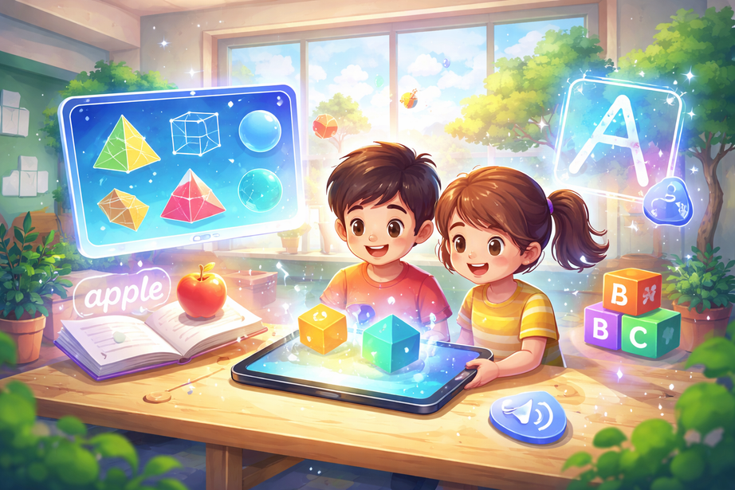

AR Educational Suite
For Primary Students’ Geometry and Literacy
R26-IM-005
SLIIT | Faculty of Computing | Interactive Media Specialization | 2026

Slide 2


PROJECT
SUPERVISION
Supervisor
Co - Supervisor
Mr. Aruna Ishara Gamage
Mr. Nushkan Nisme
Senior Lecturer
Assistant Lecturer
R26-IM-005

Slide 3
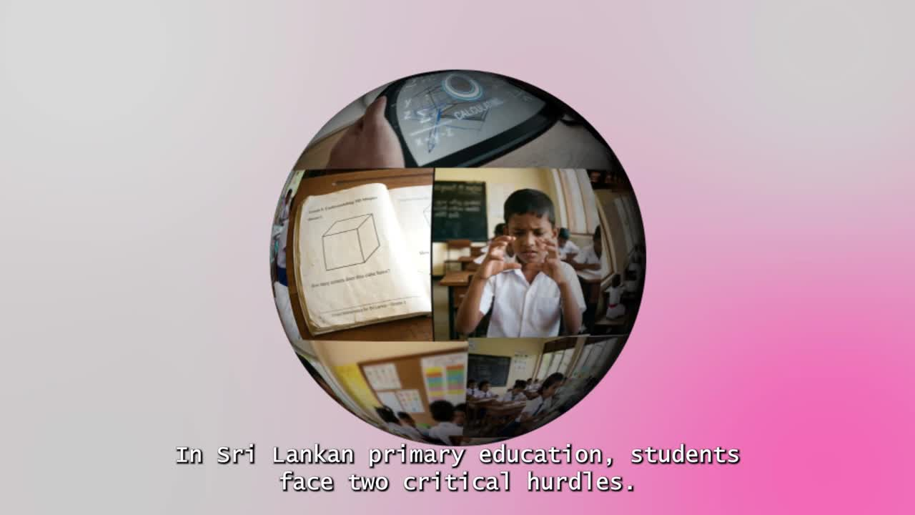
R26-IM-005

Slide 4
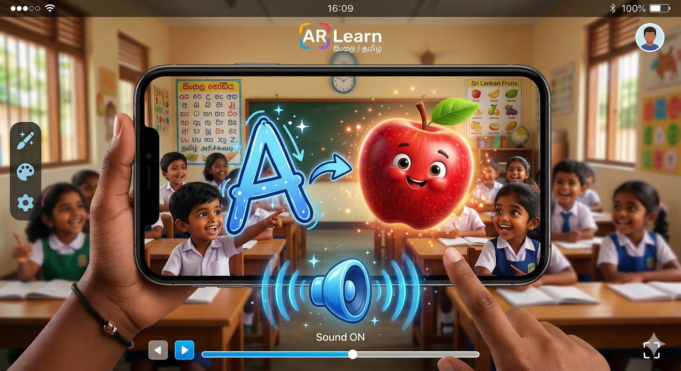
Users, Stakeholders & Impact
Users
Students ( Age 6-12 )
Stakeholders
Teachers ( Primary Grades )
Parents
Schools and Institutions
R26-IM-005

Slide 5

Students
Teachers
Difficulty understanding 3D concepts
Difficulty explaining abstract 3D concepts
Poor handwriting development
Limited tools for interactive teaching
Weak vocabulary and pronunciation
Hard to monitor individual student mistakes
Low engagement in learning
Impact
of the Research Problem
Parents
Schools / Institutions
Difficulty supporting learning at home
Limited access to advanced learning technologies
Lack of effective digital learning tools
Lower student performance in STEM subjects
Concern about child’s academic progress
Pressure to improve teaching effectivenes
R26-IM-005

Slide 6
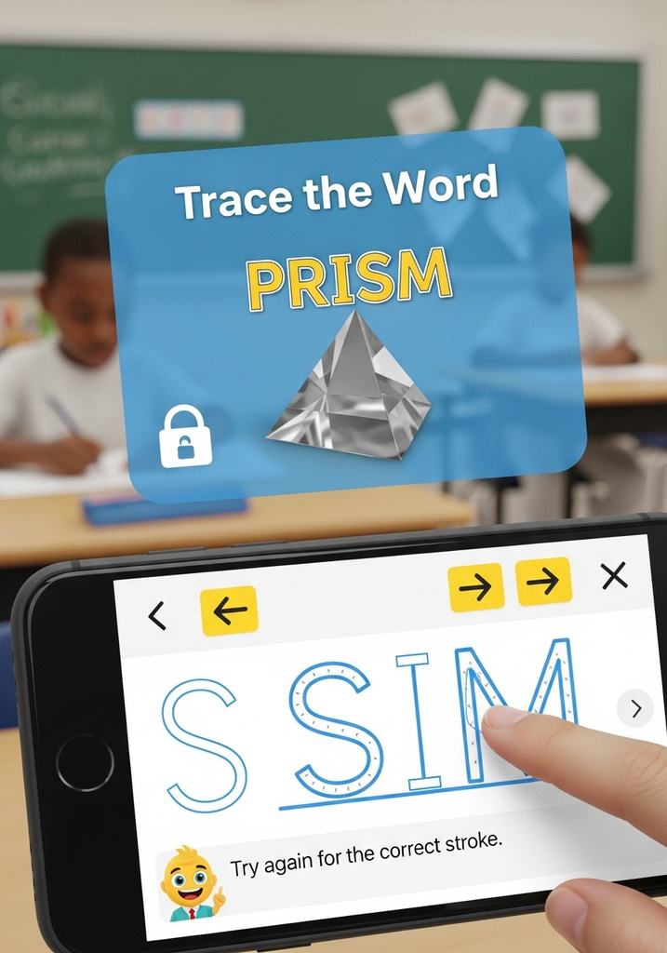
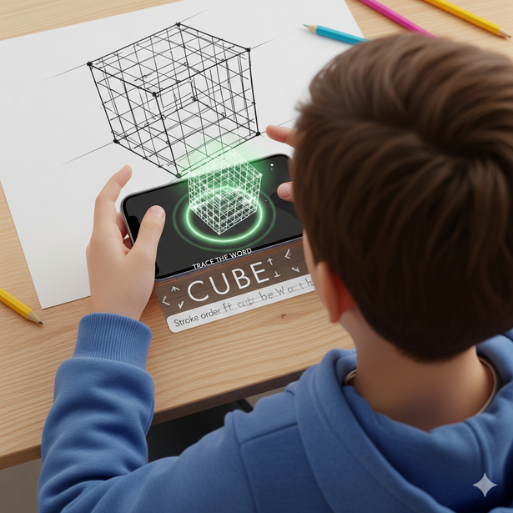
Identified
Research Problem
How can a mobile-based AI and Augmented Reality (AR) system be designed to accurately convert student-drawn 2D sketches into validated 3D geometric models, verify geometric net correctness, and simultaneously support English letter stroke guidance and vocabulary learning in a single low-cost, real-time interactive educational environment optimized for primary school learners (ages 6–12)?
R26-IM-005

Slide 7
Proposed Solution
AI-Powered Mobile AR Educational Suite
C1
2D-to-3D Geometry Validation
C2
Adaptive Scaffolding & Virtual Slicing
C3
AI Air-Writing Trajectory Tracking
C4
Multisensory Phonics & Vocabulary Learning
R26-IM-005

Slide 8
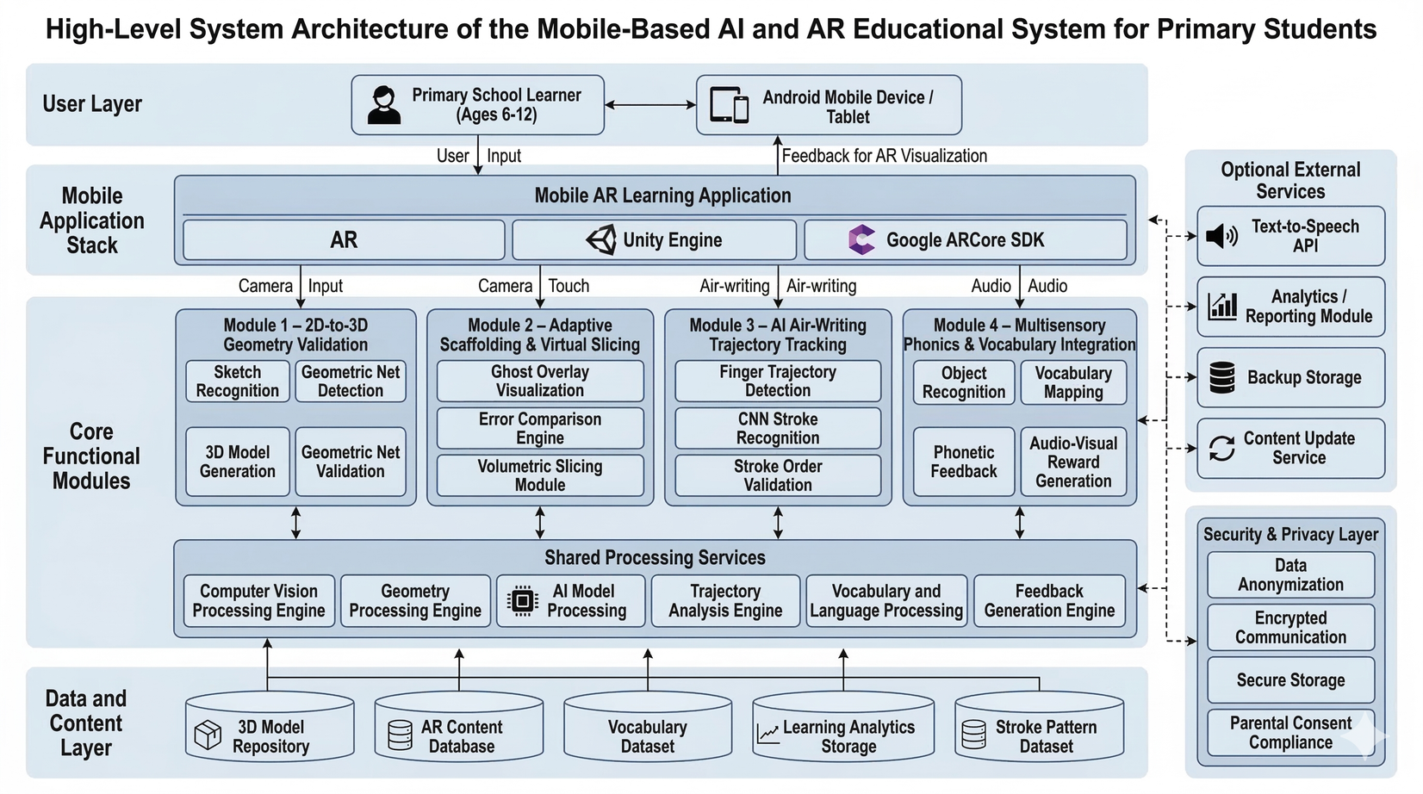
System
Architecture
R26-IM-005

Slide 9

Component 01 : 2D-to-3D Geometry Validation
IT22274298 | Himsara M.K.D.L
Contribution to Overall Project
  Develops the 2D-to-3D Geometry Validation Engine
  Transforms digital hand-drawn 2D sketches into mathematically validated 3D volumes in real-time
  Supports spatial understanding in geometry learning
Novelty
  Topological Validation Engine
  Uses an Adjacency Matrix and Euler's formula
  Combines sketch recognition with 3D model generation and validation in a single pipeline
IT22274298 | Luthira Himsara | R26-IM-005

Slide 10
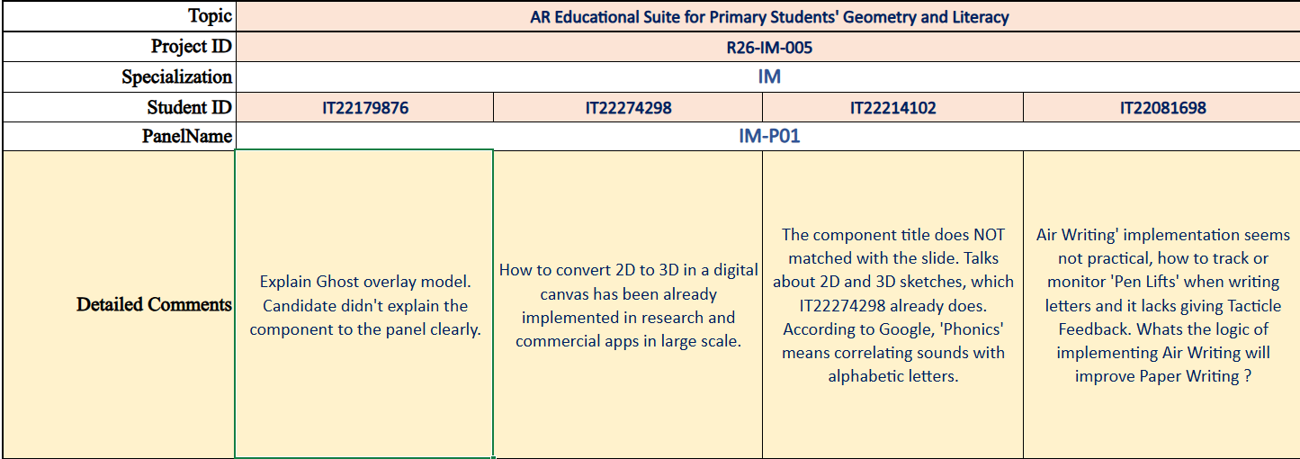
Component 01 : 2D-to-3D Geometry Validation
IT22274298 | Himsara M.K.D.L
IT22274298 | Luthira Himsara | R26-IM-005

Slide 11
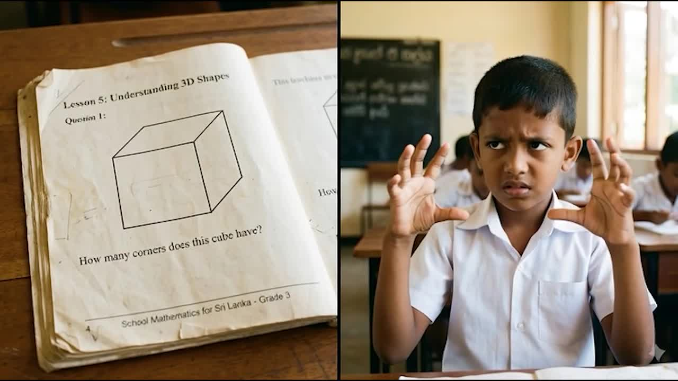
Component 01 : 2D-to-3D Geometry Validation
IT22274298 | Himsara M.K.D.L
IT22274298 | Luthira Himsara | R26-IM-005

Slide 12
Component 01 : 2D-to-3D Geometry Validation
Sub-Problem Addressed
Proposed Solution
Primary school students experience difficulties in:
  Understanding spatial errors in geometry constructions
  Connecting 2D sketches with 3D structures
  Understanding internal geometry and volume fractions
  Identifying why a geometric structure is incorrect
Existing learning systems mainly provide:
  Correct/Incorrect responses only
  Limited visual explanation
  Minimal interactive guidance
This component introduces an AR-based learning support system with two integrated modules:
Adaptive Scaffolding Module
  Detects geometry construction errors
  Highlights incorrect spatial areas
  Provides child-friendly visual guidance
  Supports comparison between student and reference structures
Virtual Slicing Module
  Visualizes internal structure of 3D models
  Demonstrates volume fractions interactively
  Supports AR-based slicing interaction
  Enhances spatial reasoning through visualization
IT22179876 | Malitha De Costa | R26-IM-005

Slide 13
Component 01 : 2D-to-3D Geometry Validation
User Requirements Addressed
Component Contribution
Educational Requirements
✔ Improve spatial understanding
✔ Support geometry visualization
✔ Enhance fraction learning
✔ Provide guided corrective feedback
Technical Requirements
✔ Mobile AR interaction
✔ Real-time visual feedback
✔ Interactive 3D visualization
✔ Android platform support
  Introduces adaptive visual feedback instead of binary responses
  Combines scaffolding and AR interaction in one learning system
  Supports interactive understanding of internal geometry
  Improves engagement through immersive educational interaction
IT22179876 | Malitha De Costa | R26-IM-005

Slide 14
Component 01 : 2D-to-3D Geometry Validation
Current Prototype Implementation
Current Prototype Implementation
AR Environment & System
✔ Unity AR environment configured
✔ XR Origin and AR Session integrated
✔ Android APK successfully tested
✔ Camera-based AR interaction working
Adaptive Scaffolding Module
✔ Guidance workflow implemented
✔ Error feedback panels integrated
✔ Visual comparison structure prepared
✔ Corrective guidance interaction completed
Virtual Slicing Module
✔ Interactive slicing workflow implemented
✔ Direction selection working
✔ Fraction selection working
✔ Trace interaction system working
✔ Slice visualization working
✔ Reset and navigation systems completed
IT22179876 | Malitha De Costa | R26-IM-005

Slide 15
Component 01 : 2D-to-3D Geometry Validation
Design Excellence
Initial Prototype Feedback
Adaptive Learning Support
  Provides visual explanation of spatial mistakes
  Supports guided geometry correction
  Enhances conceptual understanding through visualization
Interactive Geometry Visualization
  Demonstrates internal geometry structures
  Visualizes volume division interactively
  Supports active learning through AR interaction
Educational Engagement
  Encourages exploratory learning
  Increases student interaction and participation
  Simplifies abstract geometry concepts visually
Observations
  Interactive visualization improved student engagement
  AR interaction increased interest in geometry learning
  Visual slicing improved understanding of fractions
  Guided feedback improved understanding of mistakes
Future Improvements
  Add additional geometry shapes
  Improve adaptive guidance intelligence
  Enhance real-time interaction smoothness
  Expand educational evaluation features
IT22179876 | Malitha De Costa | R26-IM-005

Slide 16

Component 02 : Adaptive Scaffolding & Virtual Slicing
IT22179876 | De Costa M.M.P.
Contribution to Overall Project
  Provides visual explanation of errors instead of binary feedback
  Enhances understanding of 3D spatial relationships
  Supports geometry validation module with feedback layer
  Improves student learning through interactive AR guidance
Novelty
  Introduces ghost overlay visualization for real-time spatial comparison
  Provides visual error explanation instead of correct/incorrect feedback
  Integrates virtual slicing to reveal internal geometry and volume concepts
  Combines scaffolding + AR interaction in a single educational system
IT22179876 | Malitha De Costa | R26-IM-005

Slide 17
Component 02 : Adaptive Scaffolding & Virtual Slicing
IT22179876 | De Costa M.M.P.
IT22179876 | Malitha De Costa | R26-IM-005

Slide 18

Component 02 : Adaptive Scaffolding & Virtual Slicing
IT22179876 | De Costa M.M.P.
IT22179876 | Malitha De Costa | R26-IM-005

Slide 19
Component 02 : Adaptive Scaffolding & Virtual Slicing
Sub-Problem Addressed
Proposed Solution
Primary school students experience difficulties in:
  Understanding spatial errors in geometry constructions
  Connecting 2D sketches with 3D structures
  Understanding internal geometry and volume fractions
  Identifying why a geometric structure is incorrect
Existing learning systems mainly provide:
  Correct/Incorrect responses only
  Limited visual explanation
  Minimal interactive guidance
This component introduces an AR-based learning support system with two integrated modules:
Adaptive Scaffolding Module
  Detects geometry construction errors
  Highlights incorrect spatial areas
  Provides child-friendly visual guidance
  Supports comparison between student and reference structures
Virtual Slicing Module
  Visualizes internal structure of 3D models
  Demonstrates volume fractions interactively
  Supports AR-based slicing interaction
  Enhances spatial reasoning through visualization
IT22179876 | Malitha De Costa | R26-IM-005

Slide 20
Component 02 : Adaptive Scaffolding & Virtual Slicing
User Requirements Addressed
Component Contribution
Educational Requirements
✔ Improve spatial understanding
✔ Support geometry visualization
✔ Enhance fraction learning
✔ Provide guided corrective feedback
Technical Requirements
✔ Mobile AR interaction
✔ Real-time visual feedback
✔ Interactive 3D visualization
✔ Android platform support
  Introduces adaptive visual feedback instead of binary responses
  Combines scaffolding and AR interaction in one learning system
  Supports interactive understanding of internal geometry
  Improves engagement through immersive educational interaction
IT22179876 | Malitha De Costa | R26-IM-005

Slide 21
Component 02 : Adaptive Scaffolding & Virtual Slicing
Current Prototype Implementation
Current Prototype Implementation
AR Environment & System
✔ Unity AR environment configured
✔ XR Origin and AR Session integrated
✔ Android APK successfully tested
✔ Camera-based AR interaction working
Adaptive Scaffolding Module
✔ Guidance workflow implemented
✔ Error feedback panels integrated
✔ Visual comparison structure prepared
✔ Corrective guidance interaction completed
Virtual Slicing Module
✔ Interactive slicing workflow implemented
✔ Direction selection working
✔ Fraction selection working
✔ Trace interaction system working
✔ Slice visualization working
✔ Reset and navigation systems completed
IT22179876 | Malitha De Costa | R26-IM-005

Slide 22
Component 02 : Adaptive Scaffolding & Virtual Slicing
Design Excellence
Initial Prototype Feedback
Adaptive Learning Support
  Provides visual explanation of spatial mistakes
  Supports guided geometry correction
  Enhances conceptual understanding through visualization
Interactive Geometry Visualization
  Demonstrates internal geometry structures
  Visualizes volume division interactively
  Supports active learning through AR interaction
Educational Engagement
  Encourages exploratory learning
  Increases student interaction and participation
  Simplifies abstract geometry concepts visually
Observations
  Interactive visualization improved student engagement
  AR interaction increased interest in geometry learning
  Visual slicing improved understanding of fractions
  Guided feedback improved understanding of mistakes
Future Improvements
  Add additional geometry shapes
  Improve adaptive guidance intelligence
  Enhance real-time interaction smoothness
  Expand educational evaluation features
IT22179876 | Malitha De Costa | R26-IM-005

Slide 23

Component 03 : AI-Air Writing Trajectory Traking
IT22081698 | Abhilash K.A.T.W
Contribution to Overall Project
  Adds the literacy tracking part of the full AR learning suite
  Captures live fingertip paths while students write letters in the air
  Checks stroke start, direction, and path before the reward step
  Sends correct-letter events to the phonics and 3D reward flow
Novelty
  Real-time stroke-direction awareness – Ensures strokes follow the correct direction.
  Tracks 3D air-writing trajectories – Captures full fingertip movement in 3D, using mobile phone camera.
  Checks start point stroke order – Verifies correct start and stroke sequence.
IT22081698 | Thushad Abhilash | R26-IM-005

Slide 24
Component 03 : AI-Air Writing Trajectory Traking
IT22081698 | Abhilash K.A.T.W
IT22081698 | Thushad Abhilash | R26-IM-005

Slide 25
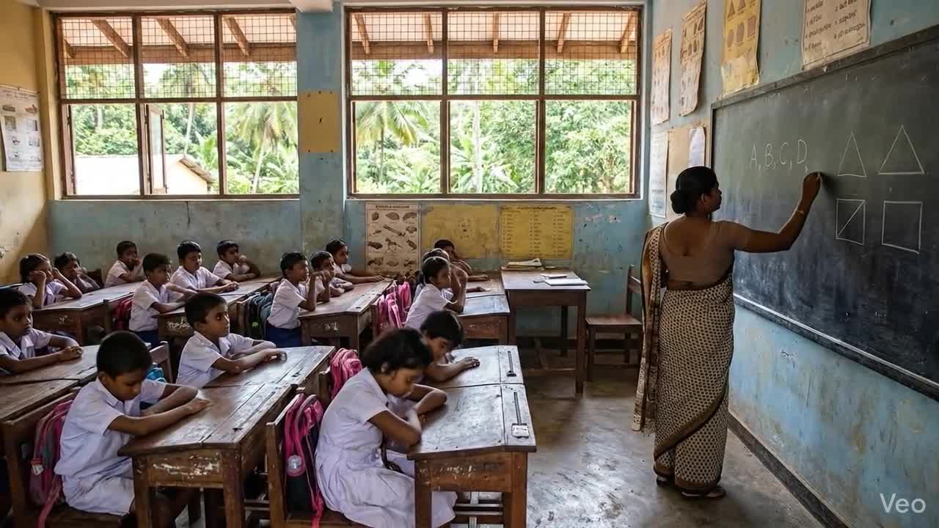
Component 03 : AI-Air Writing Trajectory Traking
IT22081698 | Abhilash K.A.T.W
IT22081698 | Thushad Abhilash | R26-IM-005

Slide 26
Component 03 : AI-Air Writing Trajectory Traking
Sub-Problem Addressed
Proposed Solution
Primary school students experience difficulties in:
  Understanding spatial errors in geometry constructions
  Connecting 2D sketches with 3D structures
  Understanding internal geometry and volume fractions
  Identifying why a geometric structure is incorrect
Existing learning systems mainly provide:
  Correct/Incorrect responses only
  Limited visual explanation
  Minimal interactive guidance
This component introduces an AR-based learning support system with two integrated modules:
Adaptive Scaffolding Module
  Detects geometry construction errors
  Highlights incorrect spatial areas
  Provides child-friendly visual guidance
  Supports comparison between student and reference structures
Virtual Slicing Module
  Visualizes internal structure of 3D models
  Demonstrates volume fractions interactively
  Supports AR-based slicing interaction
  Enhances spatial reasoning through visualization
IT22179876 | Malitha De Costa | R26-IM-005

Slide 27
Component 03 : AI-Air Writing Trajectory Traking
User Requirements Addressed
Component Contribution
Educational Requirements
✔ Improve spatial understanding
✔ Support geometry visualization
✔ Enhance fraction learning
✔ Provide guided corrective feedback
Technical Requirements
✔ Mobile AR interaction
✔ Real-time visual feedback
✔ Interactive 3D visualization
✔ Android platform support
  Introduces adaptive visual feedback instead of binary responses
  Combines scaffolding and AR interaction in one learning system
  Supports interactive understanding of internal geometry
  Improves engagement through immersive educational interaction
IT22179876 | Malitha De Costa | R26-IM-005

Slide 28
Component 03 : AI-Air Writing Trajectory Traking
Current Prototype Implementation
Current Prototype Implementation
AR Environment & System
✔ Unity AR environment configured
✔ XR Origin and AR Session integrated
✔ Android APK successfully tested
✔ Camera-based AR interaction working
Adaptive Scaffolding Module
✔ Guidance workflow implemented
✔ Error feedback panels integrated
✔ Visual comparison structure prepared
✔ Corrective guidance interaction completed
Virtual Slicing Module
✔ Interactive slicing workflow implemented
✔ Direction selection working
✔ Fraction selection working
✔ Trace interaction system working
✔ Slice visualization working
✔ Reset and navigation systems completed
IT22179876 | Malitha De Costa | R26-IM-005

Slide 29
Component 03 : AI-Air Writing Trajectory Traking
Design Excellence
Initial Prototype Feedback
Adaptive Learning Support
  Provides visual explanation of spatial mistakes
  Supports guided geometry correction
  Enhances conceptual understanding through visualization
Interactive Geometry Visualization
  Demonstrates internal geometry structures
  Visualizes volume division interactively
  Supports active learning through AR interaction
Educational Engagement
  Encourages exploratory learning
  Increases student interaction and participation
  Simplifies abstract geometry concepts visually
Observations
  Interactive visualization improved student engagement
  AR interaction increased interest in geometry learning
  Visual slicing improved understanding of fractions
  Guided feedback improved understanding of mistakes
Future Improvements
  Add additional geometry shapes
  Improve adaptive guidance intelligence
  Enhance real-time interaction smoothness
  Expand educational evaluation features
IT22179876 | Malitha De Costa | R26-IM-005

Slide 30

Component 04: Multisensory Phonics Integration
IT22214102 | Wickramasingha N.N.
Contribution to Overall Component
  Supports the literacy learning part of the full AR Educational Suite
  Connects sketching, word learning, and pronunciation in one workflow
  Converts student-drawn 2D sketches into 3D representations
  Provides AR-based reward feedback to improve engagement
  Helps primary school learners learn vocabulary in an interactive way
Novelty
  Uses the student’s own sketch as the basis for 3D generation
  Does not only display a ready-made 3D model
  Combines sketch recognition, word matching, and pronunciation validation
  Gives a completed 3D AR reward after successful learning steps
  Creates a multisensory learning loop
IT22214102 | Navoda Wickramasingha | R26-IM-005

Slide 31
Component 04: Multisensory Phonics Integration
IT22214102 | Wickramasingha N.N.
IT22214102 | Navoda Wickramasingha | R26-IM-005

Slide 32
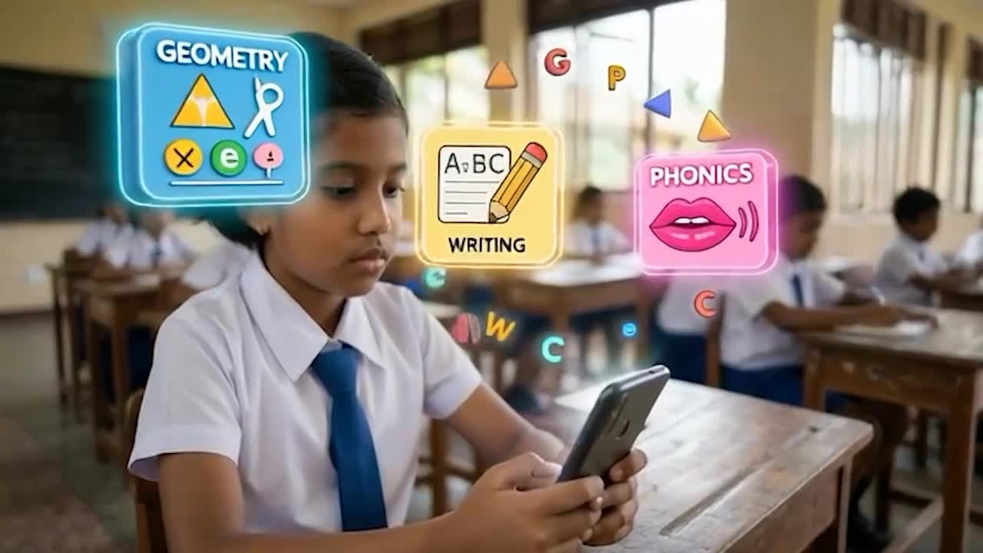
Component 04: Multisensory Phonics Integration
IT22214102 | Wickramasingha N.N.
IT22214102 | Navoda Wickramasingha | R26-IM-005

Slide 33
Component 04 : Multisensory Phonics Integration
Sub-Problem Addressed
Proposed Solution
Primary school students experience difficulties in:
  Understanding spatial errors in geometry constructions
  Connecting 2D sketches with 3D structures
  Understanding internal geometry and volume fractions
  Identifying why a geometric structure is incorrect
Existing learning systems mainly provide:
  Correct/Incorrect responses only
  Limited visual explanation
  Minimal interactive guidance
This component introduces an AR-based learning support system with two integrated modules:
Adaptive Scaffolding Module
  Detects geometry construction errors
  Highlights incorrect spatial areas
  Provides child-friendly visual guidance
  Supports comparison between student and reference structures
Virtual Slicing Module
  Visualizes internal structure of 3D models
  Demonstrates volume fractions interactively
  Supports AR-based slicing interaction
  Enhances spatial reasoning through visualization
IT22179876 | Malitha De Costa | R26-IM-005

Slide 34
Component 04 : Multisensory Phonics Integration
User Requirements Addressed
Component Contribution
Educational Requirements
✔ Improve spatial understanding
✔ Support geometry visualization
✔ Enhance fraction learning
✔ Provide guided corrective feedback
Technical Requirements
✔ Mobile AR interaction
✔ Real-time visual feedback
✔ Interactive 3D visualization
✔ Android platform support
  Introduces adaptive visual feedback instead of binary responses
  Combines scaffolding and AR interaction in one learning system
  Supports interactive understanding of internal geometry
  Improves engagement through immersive educational interaction
IT22179876 | Malitha De Costa | R26-IM-005

Slide 35
Component 04 : Multisensory Phonics Integration
Current Prototype Implementation
Current Prototype Implementation
AR Environment & System
✔ Unity AR environment configured
✔ XR Origin and AR Session integrated
✔ Android APK successfully tested
✔ Camera-based AR interaction working
Adaptive Scaffolding Module
✔ Guidance workflow implemented
✔ Error feedback panels integrated
✔ Visual comparison structure prepared
✔ Corrective guidance interaction completed
Virtual Slicing Module
✔ Interactive slicing workflow implemented
✔ Direction selection working
✔ Fraction selection working
✔ Trace interaction system working
✔ Slice visualization working
✔ Reset and navigation systems completed
IT22179876 | Malitha De Costa | R26-IM-005

Slide 36
Component 04 : Multisensory Phonics Integration
Design Excellence
Initial Prototype Feedback
Adaptive Learning Support
  Provides visual explanation of spatial mistakes
  Supports guided geometry correction
  Enhances conceptual understanding through visualization
Interactive Geometry Visualization
  Demonstrates internal geometry structures
  Visualizes volume division interactively
  Supports active learning through AR interaction
Educational Engagement
  Encourages exploratory learning
  Increases student interaction and participation
  Simplifies abstract geometry concepts visually
Observations
  Interactive visualization improved student engagement
  AR interaction increased interest in geometry learning
  Visual slicing improved understanding of fractions
  Guided feedback improved understanding of mistakes
Future Improvements
  Add additional geometry shapes
  Improve adaptive guidance intelligence
  Enhance real-time interaction smoothness
  Expand educational evaluation features
IT22179876 | Malitha De Costa | R26-IM-005

Slide 37
Commercialization / Sustainability of Solution
  Customer Persona
    Primary school students (ages 6–12)
    Schools adopting digital learning technologies
    Teachers requiring interactive educational tools
    Parents supporting home-based learning
    EdTech platforms and educational institutions
  Market Size
    Growing global EdTech and AR learning market
    Increasing adoption of mobile learning in primary education
    Large target audience across schools and home-learning environments
    Expandable to international educational markets
R26-IM-005

Slide 38
Commercialization / Sustainability of Solution
  What is Unique in Our Solution
    Combines Geometry + Literacy learning in one platform
    Integrates AR + AI + Adaptive Learning
    Provides visual error explanation instead of only correct/incorrect feedback
    Includes:
      2D-to-3D geometry validation
      Ghost overlay scaffolding
      Virtual slicing visualization
      AI air-writing recognition
      Multisensory vocabulary learning
    Fully mobile-based using Unity + ARCore
  How Will the Cost Be Recovered?
    Subscription-based licensing for schools
    Institutional partnerships with educational organizations
    Premium home-learning features for parents
    Licensing to EdTech platforms
    Future commercialization as a scalable educational product
  Sustainability of the Solution
    Scalable cloud-based mobile architecture
    Expandable educational content and modules
    Continuous updates and feature improvements
    Long-term applicability for digital and remote learning environments
R26-IM-005

Slide 39
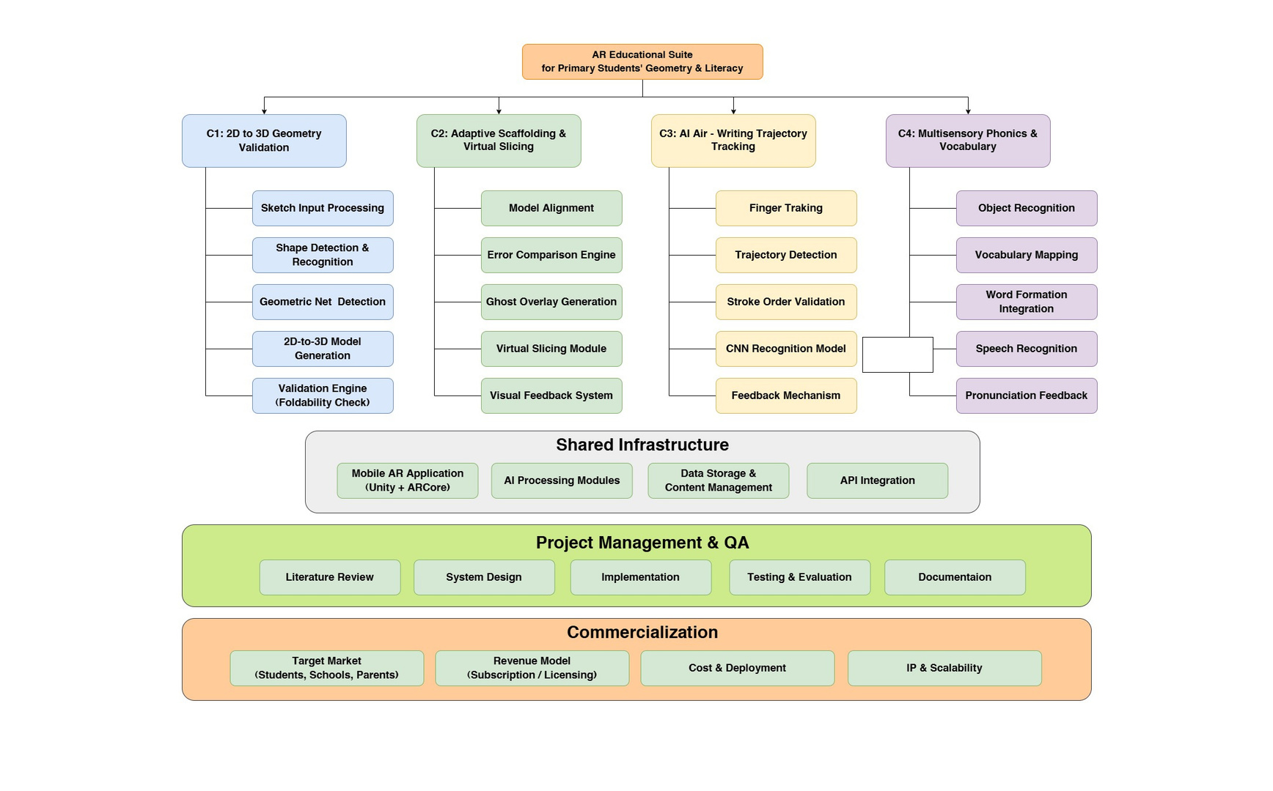
AR Educational Suite for For Primary Students’ Geometry and Literacy
Work Breakdown Structure (WBS)
R26-IM-005

Slide 40
Thank
You
We Welcome
Your Questions & Feedback
R26-IM-005

