Slide 1



AR Educational Suite
For Primary Students’ Geometry and Literacy
R26-IM-005
SLIIT | Faculty of Computing | Interactive Media Specialization | 2026

Slide 2
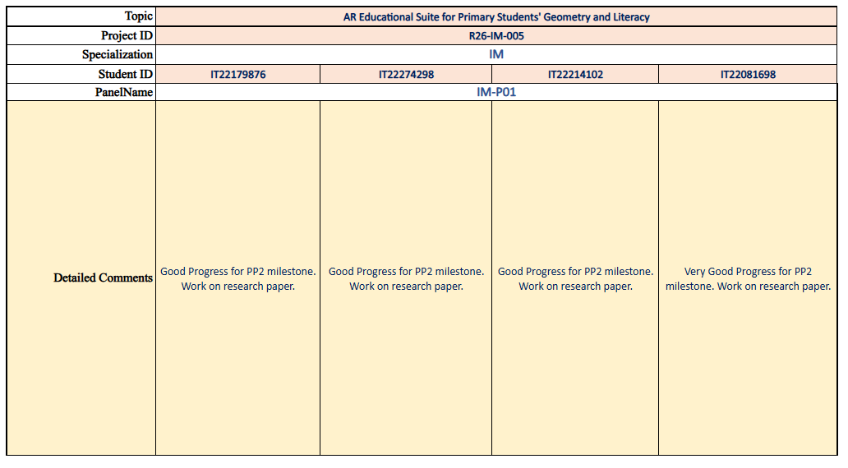
PP2 Panel feedback → actions taken
GEOLEX AR
Final development updates and supporting evidence
SLIIT | Final Research Presentation | R26-IM-005
01 / 07

Slide 3
Research problem & design excellence
GEOLEX AR
Why GeoLex AR improves the learning interaction — not just the display
THE PROBLEM
OUR DESIGN ADVANTAGE
Geometry: learners struggle to turn static 2D nets into meaningful 3D spatial understanding.
Literacy: repetitive letter and vocabulary activities give limited immediate, individualized interaction.
Primary learners need age-appropriate, active feedback — not just predefined content.
Students CREATE the input: geometric nets, slicing traces, air-written letters or object sketches.
Each component validates or recognizes the input before educational reinforcement.
C1 → C2 is a linked correction pathway; C3 and C4 use dedicated literacy processing.
SHARED INTERACTION CONTRACT
LEARNER INPUT
→
ANALYZE / RECOGNIZE
→
TARGETED FEEDBACK
→
3D / AR REINFORCEMENT
SLIIT | Final Research Presentation | R26-IM-005
02 / 07

Slide 4

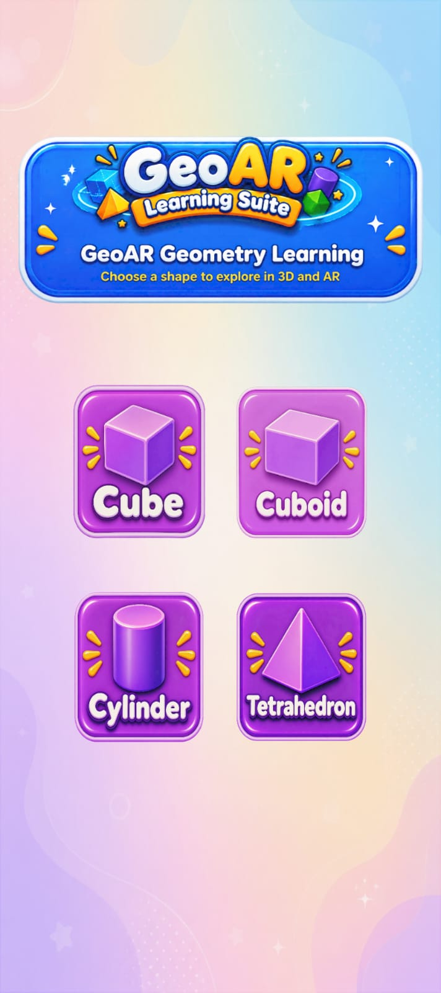
C1 | 2D-to-3D Geometry Validation
Himsara M.K.D.L. | IT22274298 | R26-IM-005
C1
Geometry validation
Rule-based checks prevent invalid nets from becoming incorrect 3D objects.
HOW IT WORKS
Checks faces, connectivity, adjacency, orientation and compatible dimensions for four supported solids.
SUPPORTED SOLIDS
Cube
Cuboid
Tetrahedron
Cylinder
2D NET
→
VALIDATION
→
VALID → 3D/AR
→
INVALID → C2
25/25
expected validity decisions matched (20 valid + 5 invalid)
ACTUAL GEOMETRY UI
IT22274298 | Himsara M.K.D.L. | R26-IM-005
03 / 07
SLIIT | Final Research Presentation | R26-IM-005

Slide 5

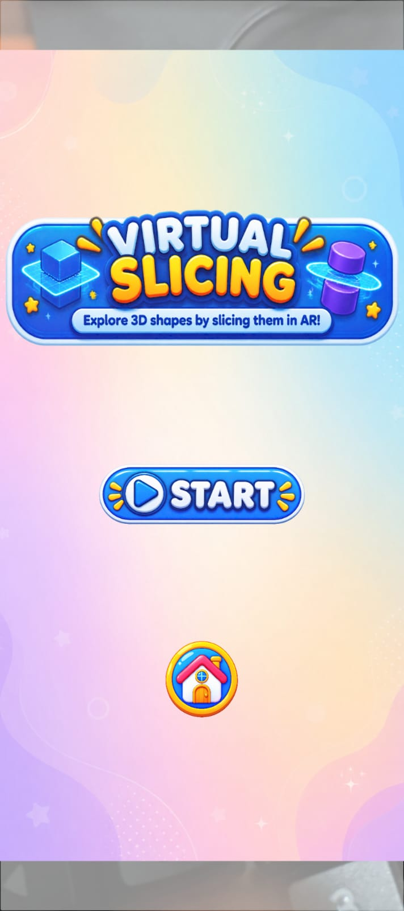
C2 | Net Correction & Virtual Slicing
De Costa M.M.P. | IT22179876 | R26-IM-005
C2
Correct • slice • inspect
2D net fault guidance, followed by fraction-aware slicing of valid 3D solids.
TWO CONNECTED EXPERIENCES
Invalid net → highlighted fault + correction guide.
3D Geometry Shapes Virtual Slicing → direction/fraction selection + slicing trace + separated parts.
SLICE DIRECTIONS
Vertical
Horizontal
Angled
FRACTIONS
1/2
1/3
1/4
3/4
20/25
successful Virtual Slicing sessions (80% completion)
ACTUAL VIRTUAL SLICING UI
IT22179876 | De Costa M.M.P. | R26-IM-005
04 / 07
SLIIT | Final Research Presentation | R26-IM-005

Slide 6

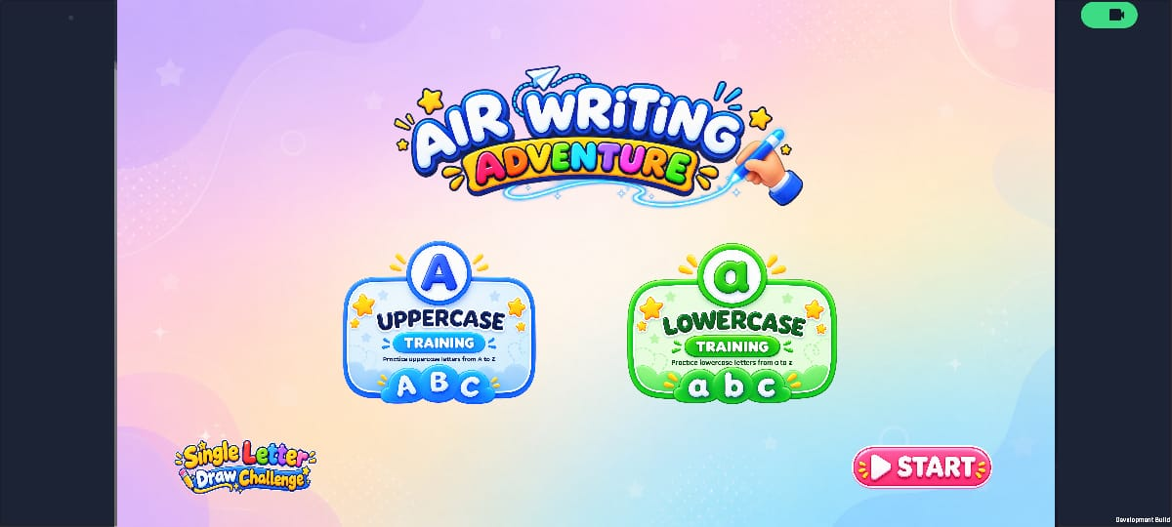
C3 | AI Air-Writing Trajectory Tracking
Abhilash K.A.T.W. | IT22081698 | R26-IM-005
C3
Write letters in free space
Camera-based fingertip tracking — not touchscreen handwriting.
HOW IT WORKS
Camera frames → hand landmarks → ordered fingertip trajectory → normalized input → CNN prediction + feedback.
CAMERA
→
FINGERTIP PATH
→
CNN PREDICTION
→
FEEDBACK
ACTUAL AIR-WRITING MODULE UI
19/25
letters correctly recognized in recorded trials (76%)
Learning feedback follows the tracked hand-motion path and model prediction.
IT22081698 | Abhilash K.A.T.W. | R26-IM-005
05 / 07
SLIIT | Final Research Presentation | R26-IM-005

Slide 7
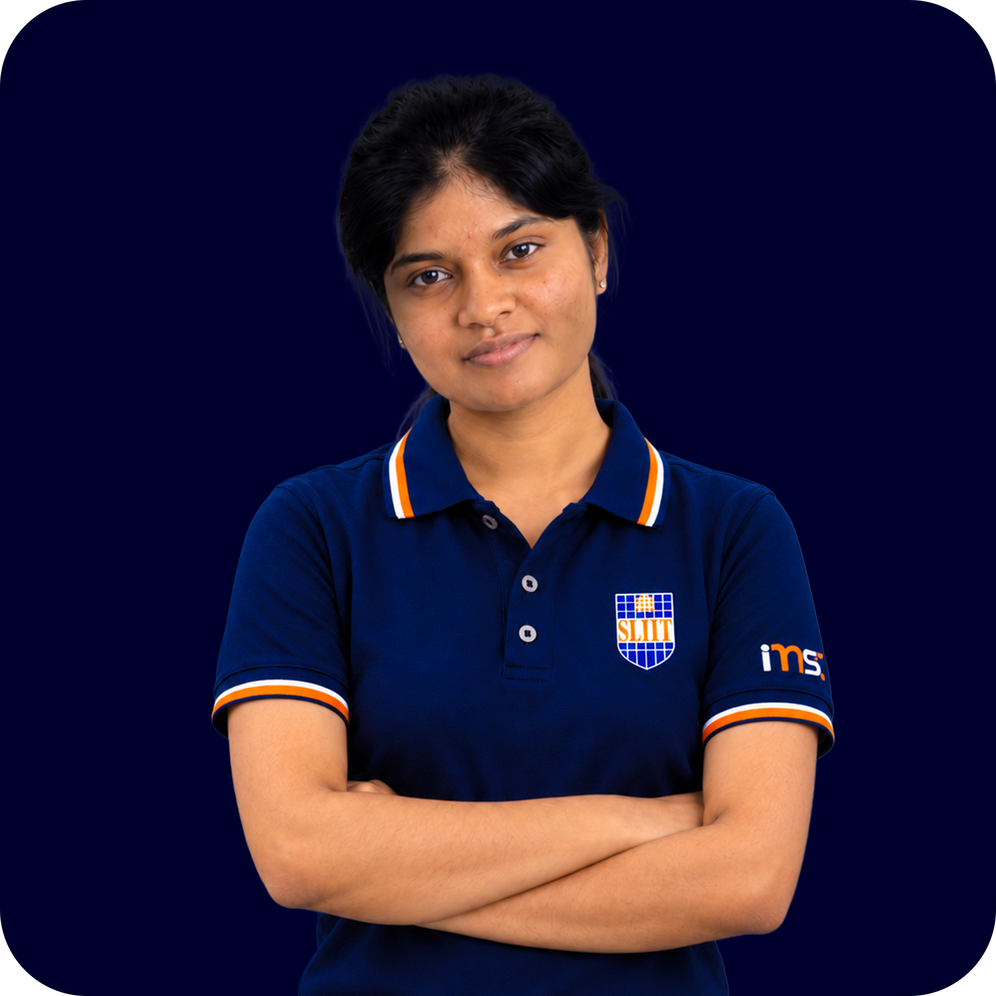
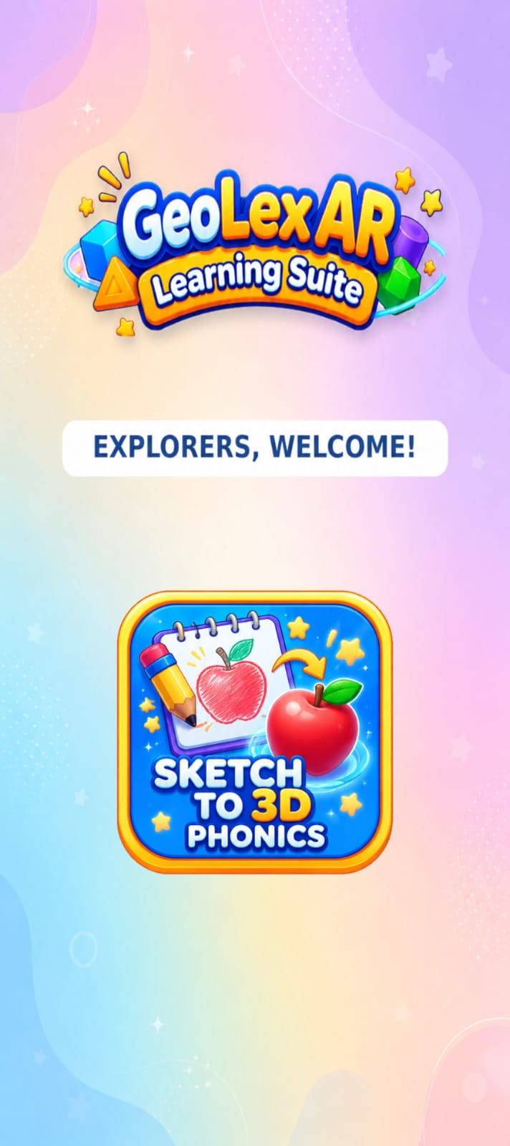
C4 | Sketch-Driven Vocabulary Learning
Wickramasingha N.N. | IT22214102 | R26-IM-005
C4
Sketch → word → AR reward
Drawing becomes the entry point for spelling and pronunciation practice.
HOW IT WORKS
A child draws a familiar object → CNN classifies it → spelling + pronunciation-oriented tasks → AR model unlocked only after both are completed.
SUPPORTED WORDS
Apple
Cat
Fish
Sun
Tree
17/25
completed the full spelling + pronunciation + AR flow (68%)
ACTUAL SKETCH MODULE UI
IT22214102 | Wickramasingha N.N. | R26-IM-005
06 / 07
SLIIT | Final Research Presentation | R26-IM-005

Slide 8
Evaluation, user evidence & limitations
GEOLEX AR
Complete integrated prototype • Real primary-school user testing
50 UNIQUE LEARNERS
25 learners aged 9–12 tested C1 + C2 | 25 learners aged 6–8 tested C3 + C4
COMPONENT-SPECIFIC OUTCOMES
PRE / POST LEARNING MEANS
C1
Net validity agreement
100%
C1
5 / 10
→
9 / 10
C2
Slicing session completion
80%
C2
5 / 10
→
9 / 10
C3
Letter recognition (sample)
76%
C3
5 / 10
→
9 / 10
C4
4 / 10
→
8 / 10
C4
Full vocabulary/AR workflow
68%
Pre/Post gains are descriptive group means; no significance claim.
NOTE: Metrics measure different tasks; they are not directly comparable AI accuracy rates.
LIMITATIONS
Small sample; C2 correction not separately quantified; C3 letters limited to 17 uppercase targets; C4 lacks child-sketch ground-truth labels.
SLIIT | Final Research Presentation | R26-IM-005
07 / 07

Slide 9
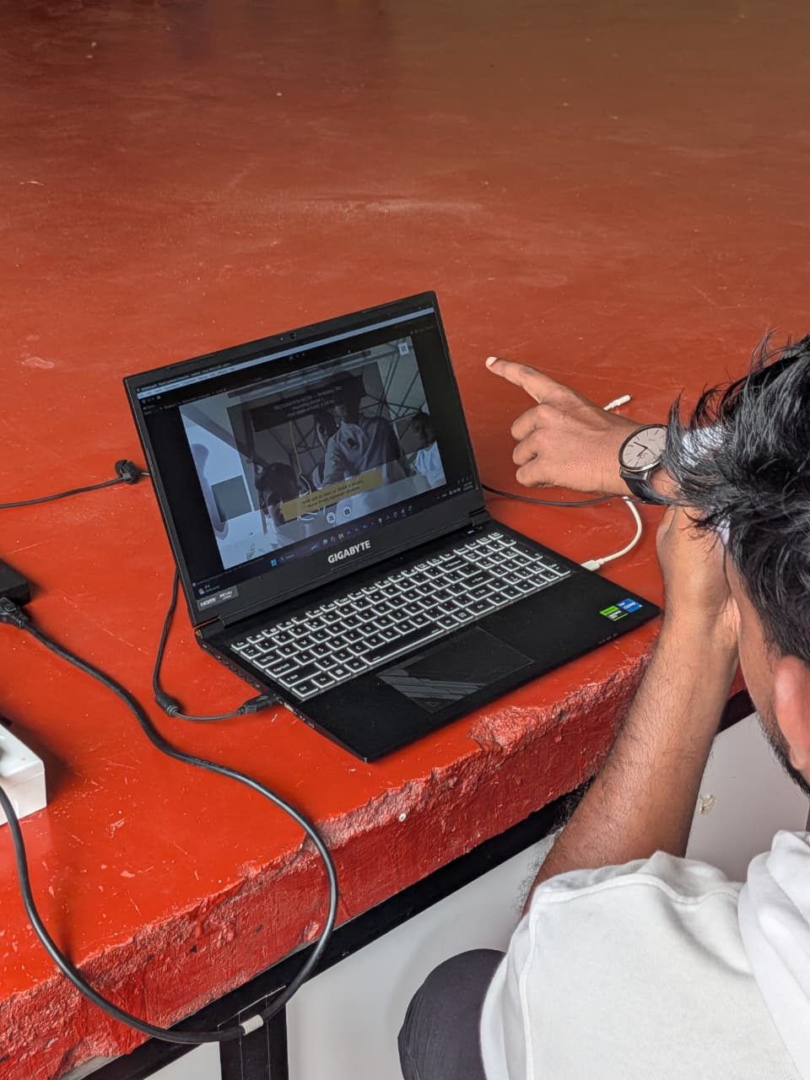
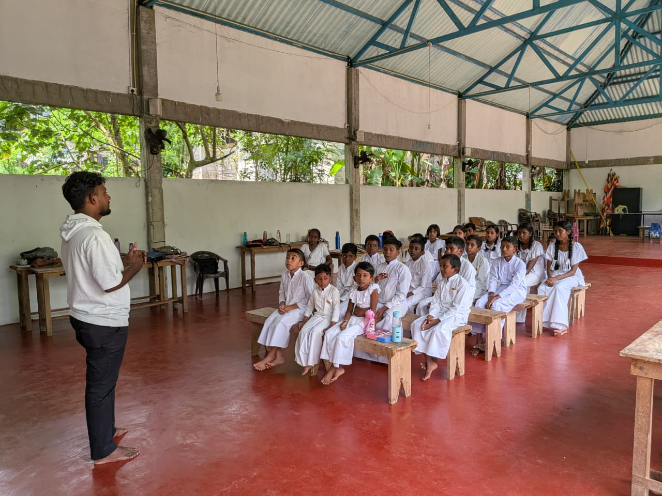
Evaluation, user evidence & limitations
Complete integrated prototype • Real primary-school user testing
SLIIT | Final Research Presentation | R26-IM-005
07 / 07

Slide 10
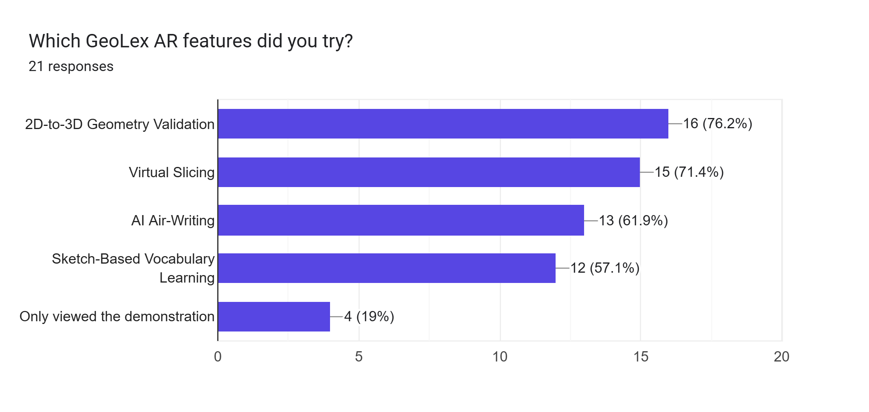
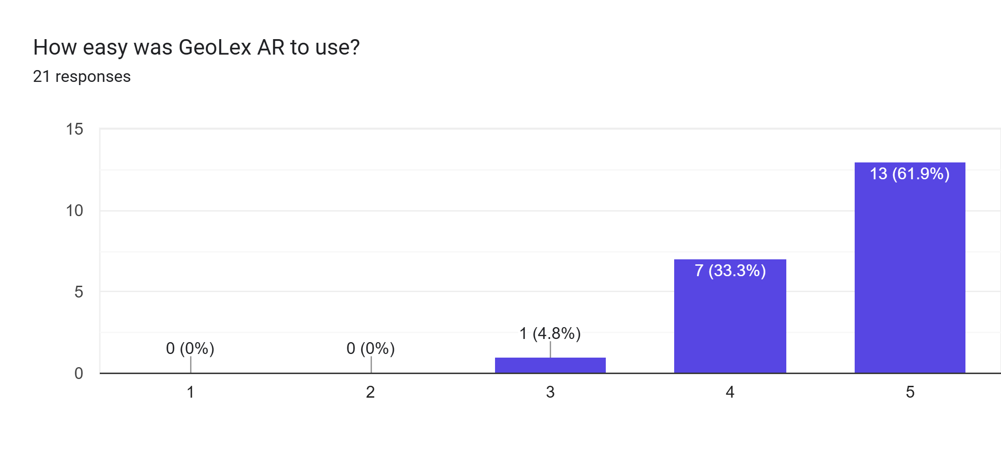
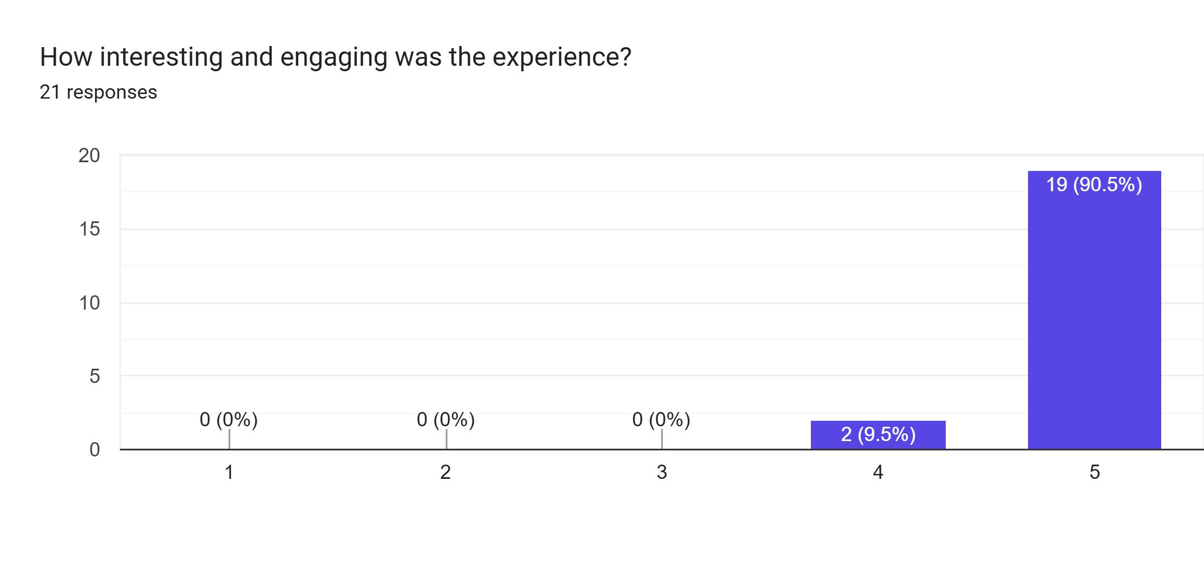
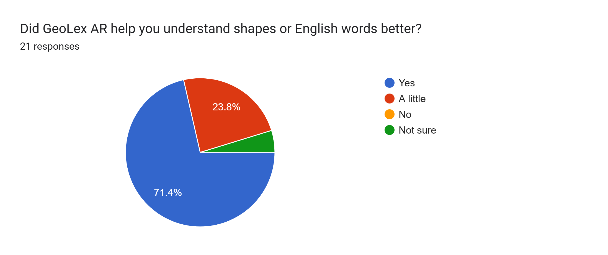
User Feedbacks
Complete integrated prototype • Real primary-school user testing
SLIIT | Final Research Presentation | R26-IM-005
07 / 07

Slide 11
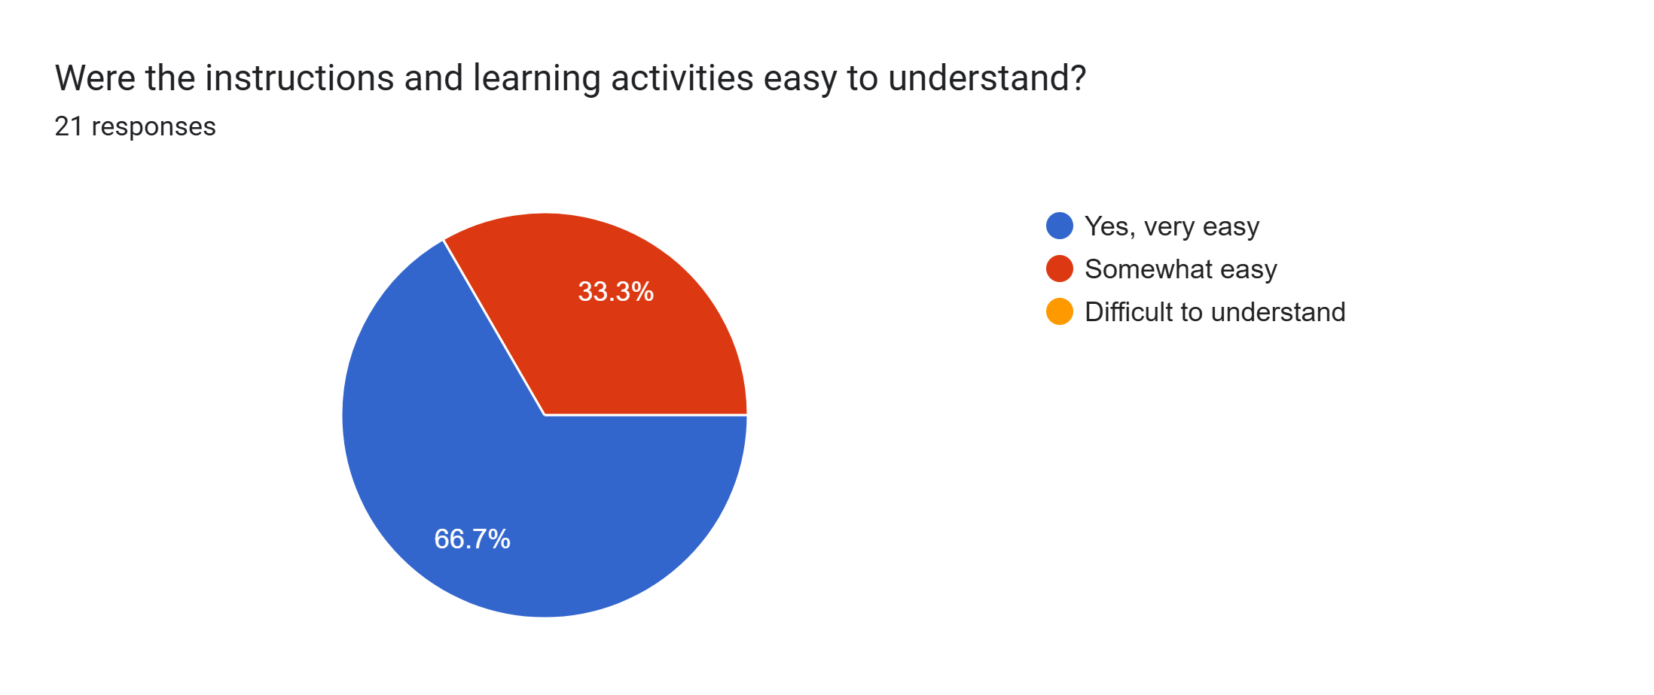
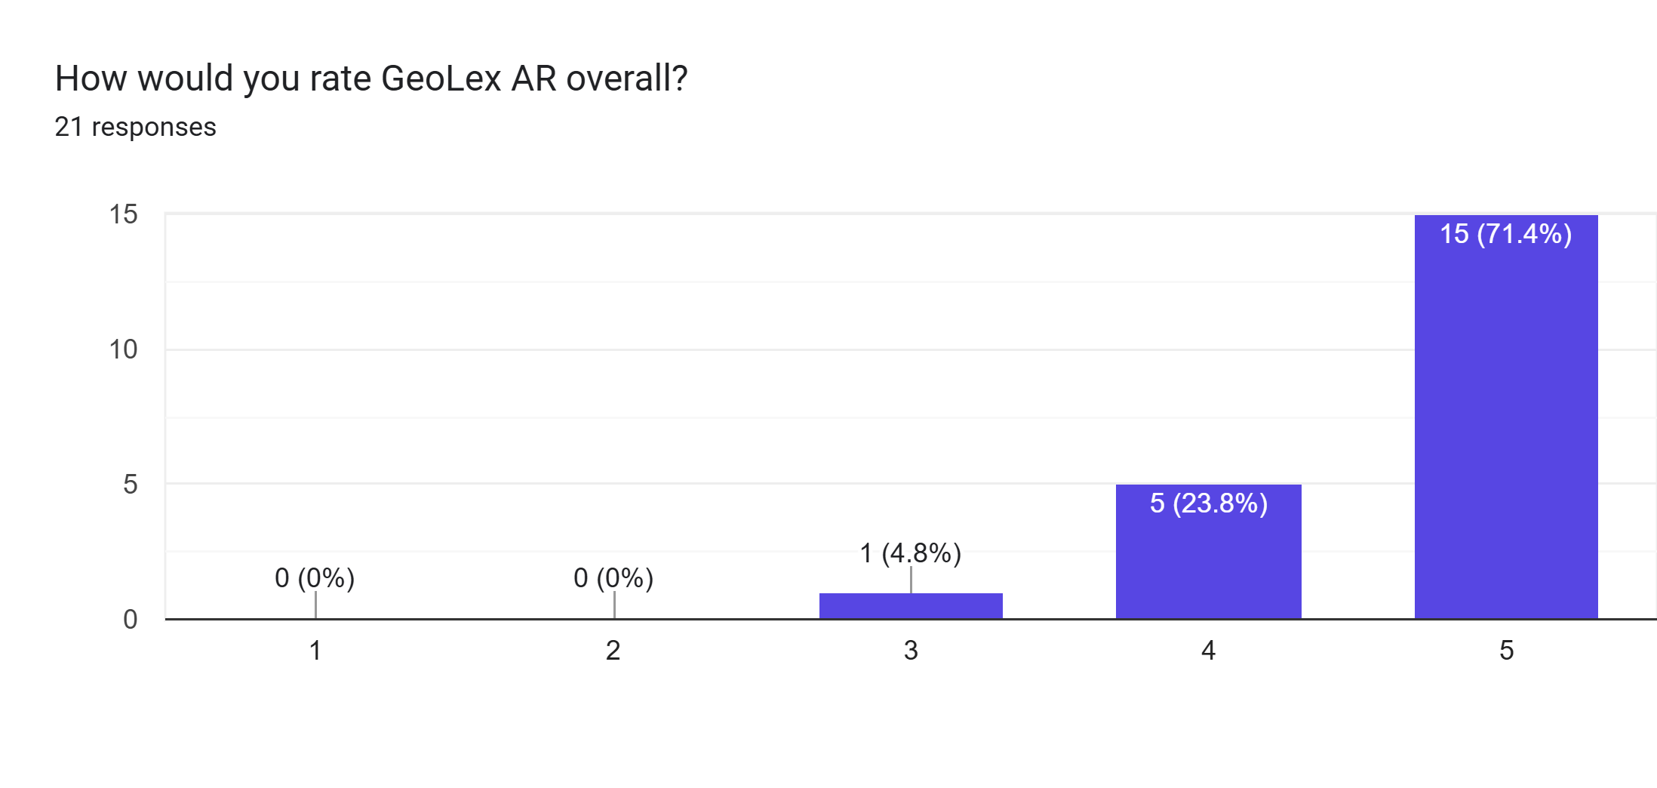
User Feedbacks
Complete integrated prototype • Real primary-school user testing
1Platform Availability: Develop and release iOS and Google Play Store versions, alongside making it available on a purchasable platform.
Performance and Features: Improve the smoothness of hand tracking and air writing features, add audio guidance, and expand the sketch-based module with more objects.
Localization: Add support for the Sinhala language.
SLIIT | Final Research Presentation | R26-IM-005
07 / 07

